Slide 1
Machine Learning
Lecture 14: Decision Tree

Slide 2
Decision Tree
A type of supervised machine learning algorithm.
The Goal: Build a decision tree in which the data is continuously split according to a certain parameter.
A decision tree is a tree, where
Decision Node: each non-leaf node has associated with it an attribute (feature)
Leaf Node: each leaf node has associated with it a classification (+ or -)
Edge: each edge is associated with it one of the possible values of the attribute at the node from which the edge is directed.

Slide 3
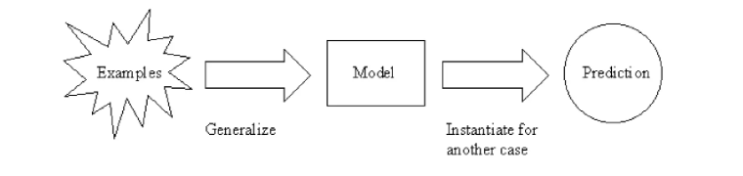
It is one of the most widely used and practical methods for inductive inference.
Inductive Inference: A "bottom-up" reasoning process where specific observations or data patterns are used to form broader, probabilistic generalizations or theories.

Slide 4
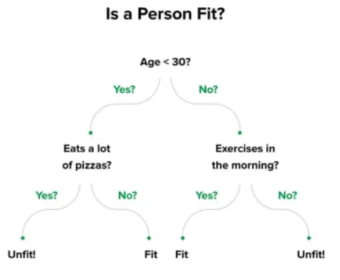
Example

Slide 5
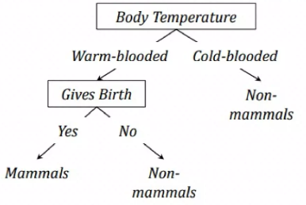

Slide 6
How well does it work?
Many case studies have shown that decision trees are at least as accurate as human experts.
A study for diagnosing breast cancer had humans correctly classifying the examples 65% of the time; the decision tree classified 72% correct
British Petroleum designed a decision tree for gas-oil separation for offshore oil platforms that replaced an earlier rule-based expert system
Cessna designed an airplane flight controller using 90,000 examples and 20 attributes per example.

Slide 7
Constructing Decision Tree: ID3
ID3 stands for Interactive Dichotomizer (version 3).
A greedy algorithm for decision tree construction developed by Ross Quinlan, 1987.
Top-down construction of the decision tree by recursively selecting the “best attribute/feature” to use at the current node in the tree.
Once the attribute is selected for the current node, generate children nodes, one for each possible value of the selected attribute.
Partition the examples using the possible values of this attribute, and assign these subsets of the examples to the appropriate child node.
Repeat for each child node until all examples associated with a node are either all positive or all negative.

Slide 8
Choosing the best “attribute/feature”
The first step of ID3 is to find the root node.
Some possibilities are:
Random: Select any attribute at random
Least-Values: Choose the attribute with the smallest number of possible values
Most-Values: Choose the attribute with the largest number of possible values
Max-Gain: Choose the attribute that has the largest expected information gain–i.e., the attribute that will result in the smallest expected size of the subtrees rooted at its children.
The ID3 algorithm uses the Max-Gain method of selecting the best attribute.

Slide 9
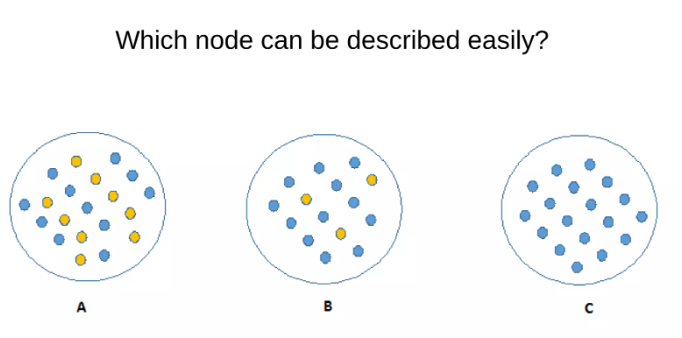

Slide 10
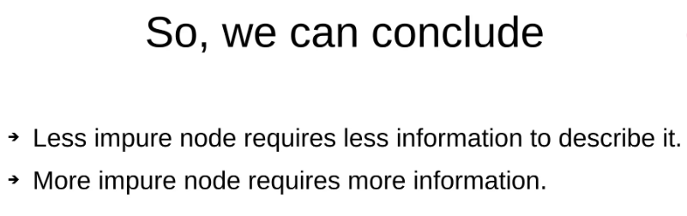
To define this disorganization/impurity in data we use a measure called entropy.

Slide 11

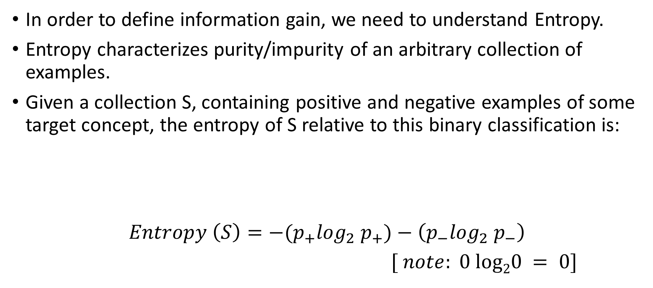
Entropy
In order to define information gain, we need to understand Entropy.
Entropy characterizes purity/impurity of an arbitrary collection of examples.
Given a collection S, containing positive and negative examples of some target concept, the entropy of S relative to this binary classification is:
$$Entropy \left(S\right)={−(p}_{+}\log_{2}{ p}_{+})−\left(p_{−}\log_{2}{ p}_{−}\right)$$
$[ note: 0 log20 = 0]$

Slide 12
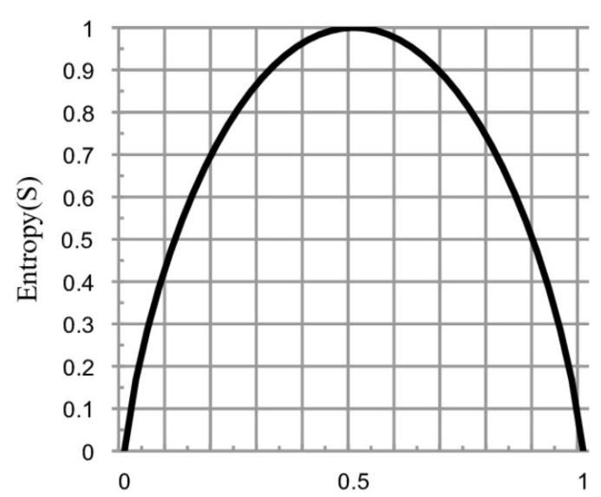
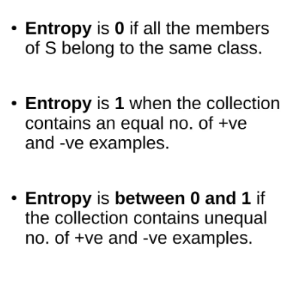

Slide 13
Exercise
Suppose S is the collection (dataset) of 14 examples of a binary classification, including 9 positive and 5 negative examples. Find the entropy of S.
Now, assume that the dataset S have 14 examples having all 14 positive and 0 negative examples. Find the entropy of S.
When, S has 7 positive and 7 negative examples. Find the entropy.

Slide 14
Information Gain
Given entropy as the measure of the impurity in a collection of training examples, we can now define the measure of the effectiveness of an attribute in classifying the training data.
The measure called information gain, is simply the expected reduction in entropy caused by partitioning the examples according to this attribute.
To minimize the decision tree depth, the attribute with the most entropy reduction is the best choice.

Slide 15
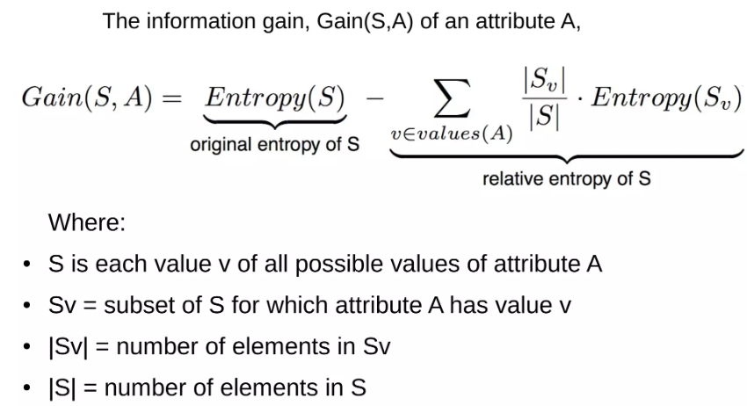

Slide 16
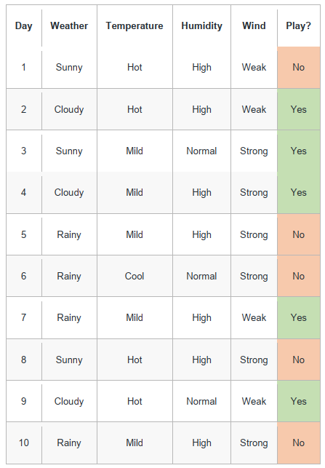
Examples
Training data, where the Y label
is whether the child goes out to
play or not.

Slide 17

Step 1: Calculate Entropy(S) of entire dataset
$$S\{+5, −5\}={−(p}_{+}\log_{2}{ p}_{+})−\left(p_{−}\log_{2}{ p}_{−}\right)$$
$=−(\frac{5}{10}\log_{2}\frac{5}{10})−\left(\frac{5}{10}\log_{2}\frac{5}{10}\right)$
$=−\left(0.5\log_{2}0.5\right)−\left(0.5\log_{2} 0.5\right)$
$=1$

Slide 18
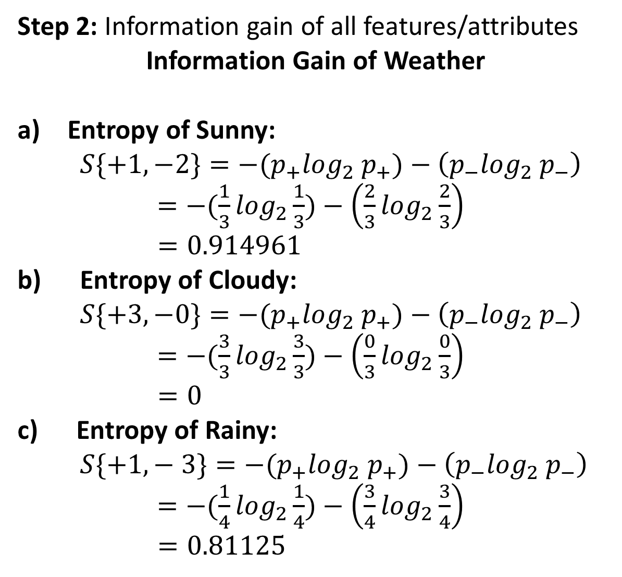
Step 2: Information gain of all features/attributes
Information Gain of Weather
Entropy of Sunny:
$S\{+1, −2\}={−(p}_{+}\log_{2}{ p}_{+})−\left(p_{−}\log_{2}{ p}_{−}\right)$
$=−(\frac{1}{3}\log_{2}\frac{1}{3})−\left(\frac{2}{3}\log_{2}\frac{2}{3}\right)$
$=0.914961$
b) Entropy of Cloudy:
$S\{+3, −0\}={−(p}_{+}\log_{2}{ p}_{+})−\left(p_{−}\log_{2}{ p}_{−}\right)$
$=−(\frac{3}{3}\log_{2}\frac{3}{3})−\left(\frac{0}{3}\log_{2}\frac{0}{3}\right)$
$=0$
c) Entropy of Rainy:
$S\{+1,− 3\}={−(p}_{+}\log_{2}{ p}_{+})−\left(p_{−}\log_{2}{ p}_{−}\right)$
$=−(\frac{1}{4}\log_{2}\frac{1}{4})−\left(\frac{3}{4}\log_{2}\frac{3}{4}\right)$
$=0.81125$

Slide 19
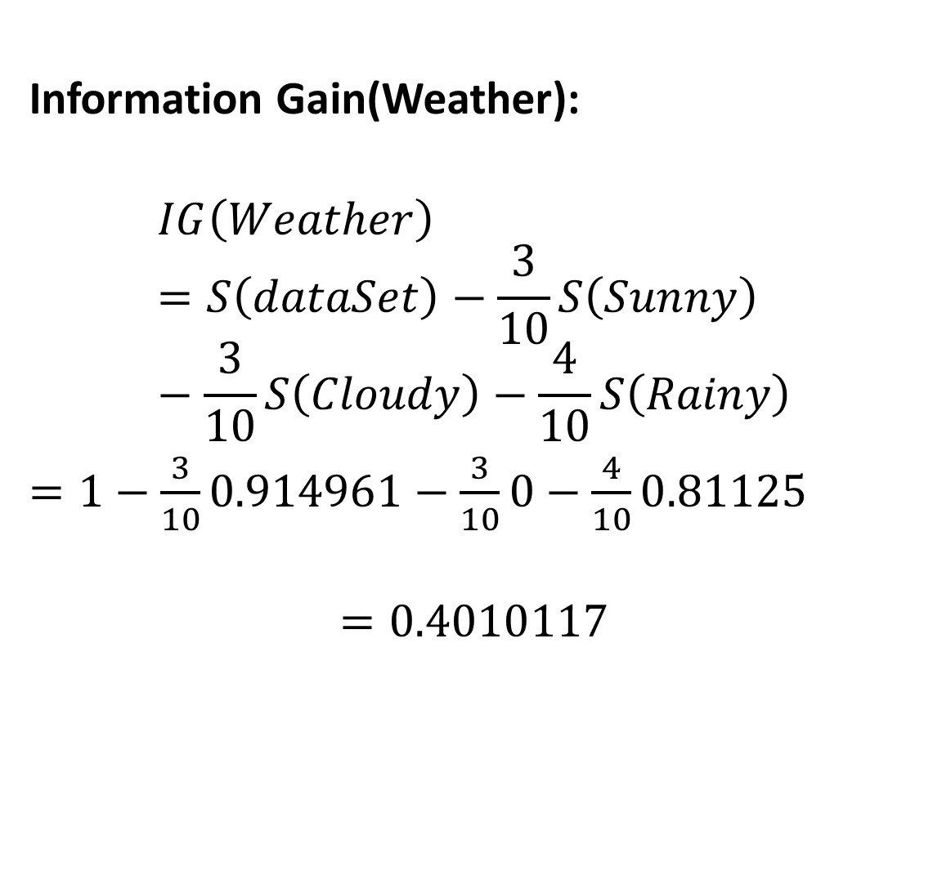
Information Gain(Weather):
$$IG\left(Weather\right)=S\left(dataSet\right)−\frac{3}{10}S\left(Sunny\right)−\frac{3}{10}S\left(Cloudy\right)−\frac{4}{10}S\left(Rainy\right)$$
$=1−$ $\frac{3}{10}0.914961−\frac{3}{10}0−\frac{4}{10}0.81125$
$$=0.4010117$$

Slide 20
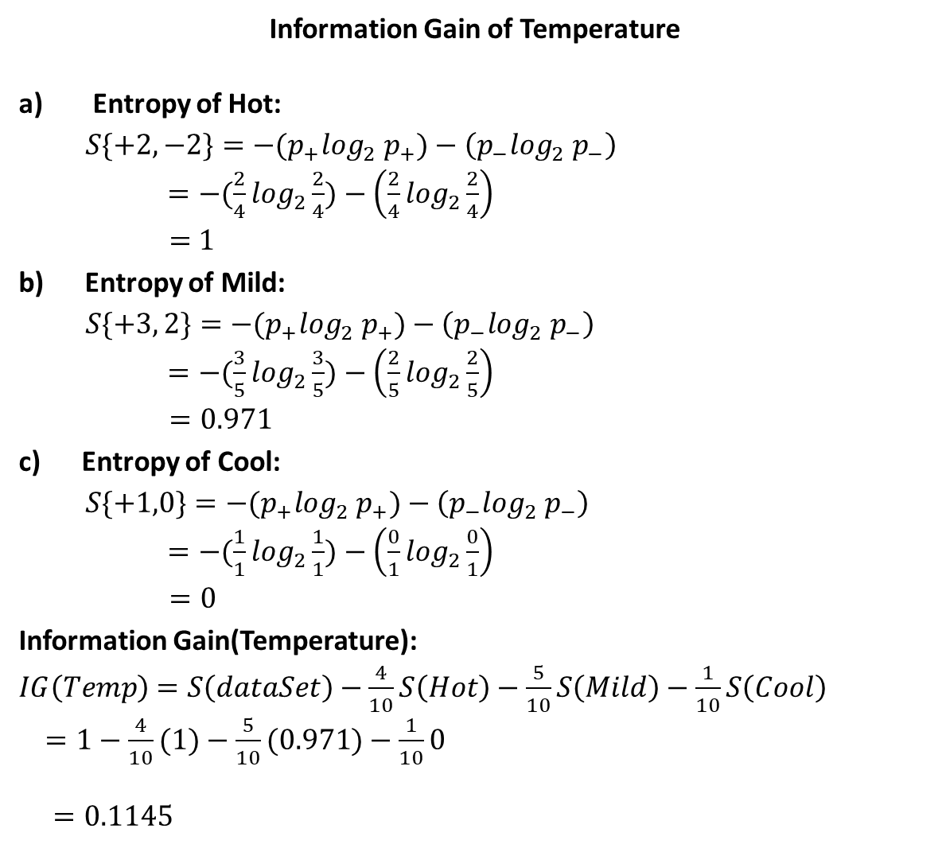
Information Gain of Temperature
Entropy of Hot:
$S\{+2, −2\}={−(p}_{+}\log_{2}{ p}_{+})−\left(p_{−}\log_{2}{ p}_{−}\right)$
$=−(\frac{2}{4}\log_{2}\frac{2}{4})−\left(\frac{2}{4}\log_{2}\frac{2}{4}\right)$
$=$ $1$
b) Entropy of Mild:
$S\{+3, 2\}={−(p}_{+}\log_{2}{ p}_{+})−\left(p_{−}\log_{2}{ p}_{−}\right)$
$=−(\frac{3}{5}\log_{2}\frac{3}{5})−\left(\frac{2}{5}\log_{2}\frac{2}{5}\right)$
$=0.971$
c) Entropy of Cool:
$S\{+1,0\}={−(p}_{+}\log_{2}{ p}_{+})−\left(p_{−}\log_{2}{ p}_{−}\right)$
$=−(\frac{1}{1}\log_{2}\frac{1}{1})−\left(\frac{0}{1}\log_{2}\frac{0}{1}\right)$
$=0$
Information Gain(Temperature):
$IG\left(Temp\right)$ $=S\left(dataSet\right)−\frac{4}{10}S\left(Hot\right)−\frac{5}{10}S\left(Mild\right)−\frac{1}{10}S\left(Cool\right)$
$=1−$ $\frac{4}{10}(1)−\frac{5}{10}(0.971)−\frac{1}{10}0$
$=0.1145$

Slide 21
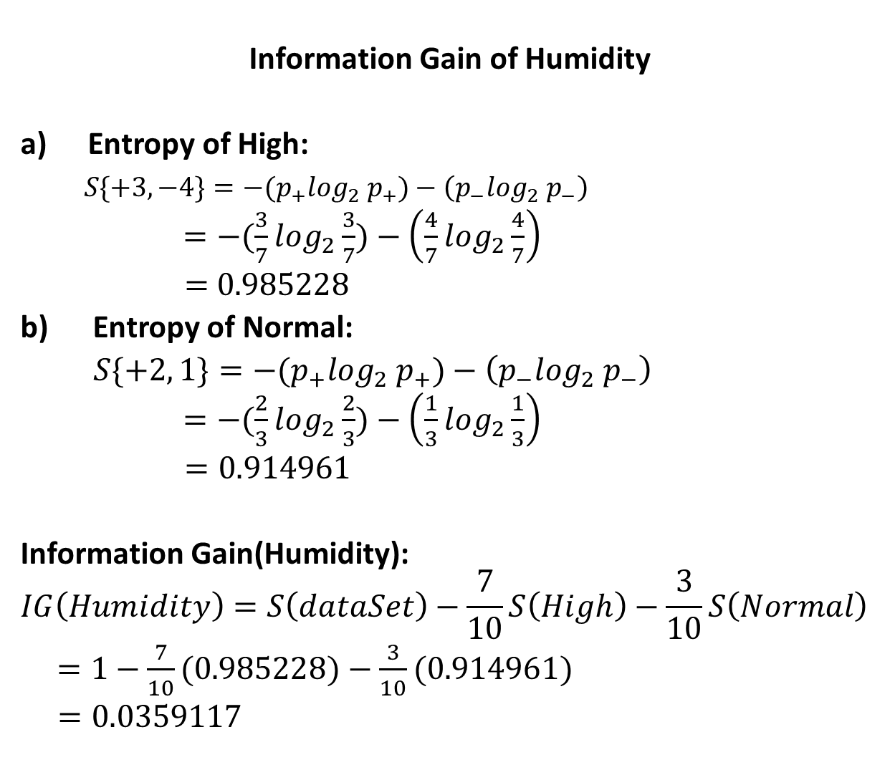
Information Gain of Humidity
Entropy of High:
$S\{+3, −4\}={−(p}_{+}\log_{2}{ p}_{+})−\left(p_{−}\log_{2}{ p}_{−}\right)$
$=−(\frac{3}{7}\log_{2}\frac{3}{7})−\left(\frac{4}{7}\log_{2}\frac{4}{7}\right)$
$=$ $0.985228$
b) Entropy of Normal:
$S\{+2, 1\}={−(p}_{+}\log_{2}{ p}_{+})−\left(p_{−}\log_{2}{ p}_{−}\right)$
$=−(\frac{2}{3}\log_{2}\frac{2}{3})−\left(\frac{1}{3}\log_{2}\frac{1}{3}\right)$
$=0.914961$
Information Gain(Humidity):
$$IG\left(Humidity\right)=S\left(dataSet\right)−\frac{7}{10}S\left(High\right)−\frac{3}{10}S\left(Normal\right)$$
$=1−$ $\frac{7}{10}(0.985228)−\frac{3}{10}(0.914961)$
$=0.0359117$

Slide 22
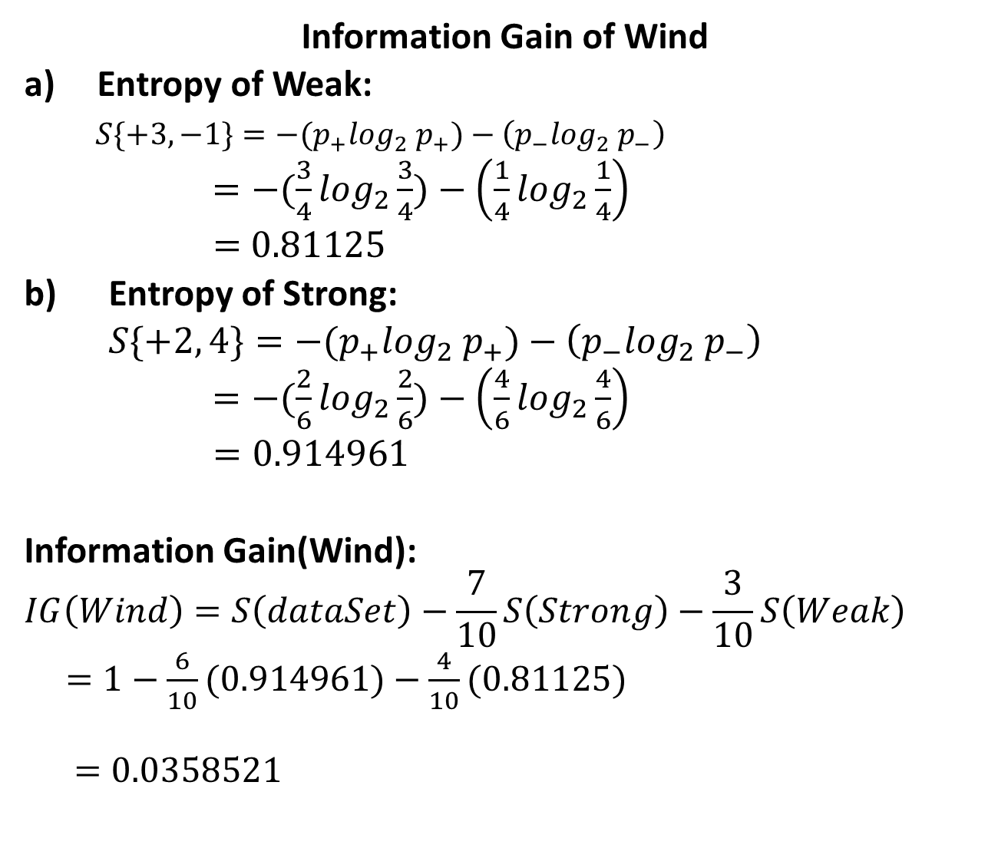
Information Gain of Wind
Entropy of Weak:
$S\{+3, −1\}={−(p}_{+}\log_{2}{ p}_{+})−\left(p_{−}\log_{2}{ p}_{−}\right)$
$=−(\frac{3}{4}\log_{2}\frac{3}{4})−\left(\frac{1}{4}\log_{2}\frac{1}{4}\right)$
$=$ $0.81125$
b) Entropy of Strong:
$S\{+2, 4\}={−(p}_{+}\log_{2}{ p}_{+})−\left(p_{−}\log_{2}{ p}_{−}\right)$
$=−(\frac{2}{6}\log_{2}\frac{2}{6})−\left(\frac{4}{6}\log_{2}\frac{4}{6}\right)$
$=0.914961$
Information Gain(Wind):
$$IG\left(Wind\right)=S\left(dataSet\right)−\frac{7}{10}S\left(Strong\right)−\frac{3}{10}S\left(Weak\right)$$
$=1−$ $\frac{6}{10}(0.914961)−\frac{4}{10}(0.81125)$
$$=0.0358521$$

Slide 23
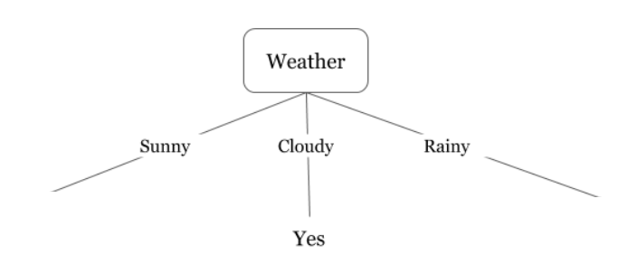

$$IG (Weather)=0.4010$$
$$IG\left(Temperature\right)=0.1145$$
$$IG\left(Humidity\right)=0.0359$$
$$IG\left(Wind\right)=0.0359$$

Slide 24
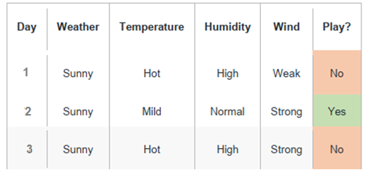
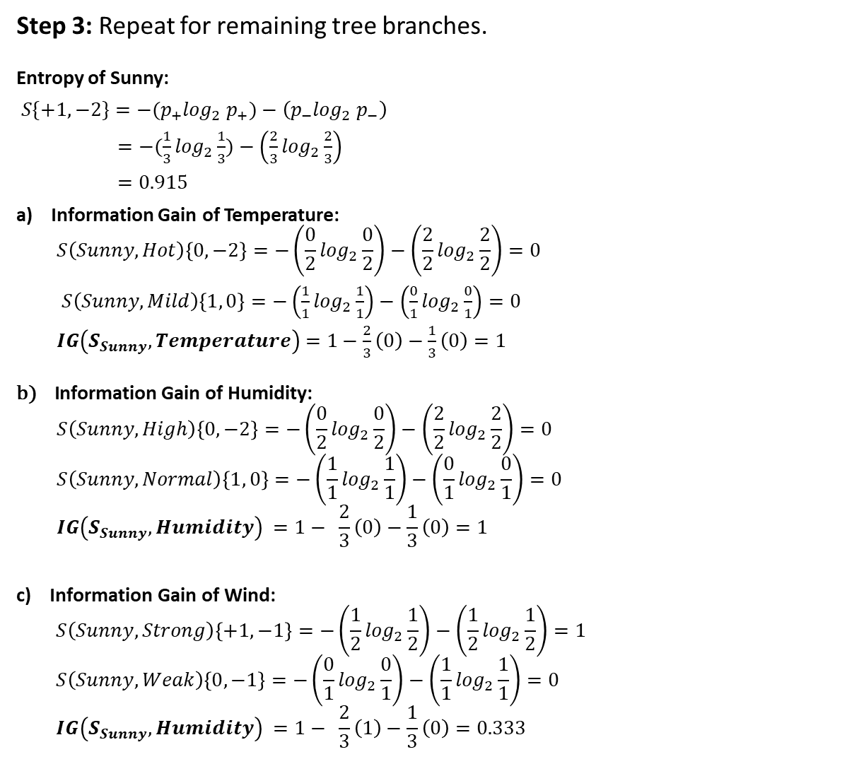
Step 3: Repeat for remaining tree branches.
Entropy of Sunny:
$S\{+1, −2\}={−(p}_{+}\log_{2}{ p}_{+})−\left(p_{−}\log_{2}{ p}_{−}\right)$
$=−(\frac{1}{3}\log_{2}\frac{1}{3})−\left(\frac{2}{3}\log_{2}\frac{2}{3}\right)$
$=0.915$
a) Information Gain of Temperature:
$$S\left(Sunny, Hot\right)\left\{0, −2\right\}=−\left(\frac{0}{2}\log_{2}\frac{0}{2}\right)−\left(\frac{2}{2}\log_{2}\frac{2}{2}\right)=0$$
$S\left(Sunny, Mild\right)\left\{1, 0\right\}=−\left(\frac{1}{1}\log_{2}\frac{1}{1}\right)−\left(\frac{0}{1}\log_{2}\frac{0}{1}\right)=0$
$IG\left(S_{Sunny}, Temperature\right)$ $=1−$ $\frac{2}{3}\left(0\right)−\frac{1}{3}\left(0\right)=1$
$$\text{b}\text{) }\text{Information} \text{Gain} \text{of} \text{Humidity}\text{:}$$
$$S\left(Sunny, High\right)\left\{0, −2\right\}=−\left(\frac{0}{2}\log_{2}\frac{0}{2}\right)−\left(\frac{2}{2}\log_{2}\frac{2}{2}\right)=0$$
$$S\left(Sunny, Normal\right)\left\{1, 0\right\}=−\left(\frac{1}{1}\log_{2}\frac{1}{1}\right)−\left(\frac{0}{1}\log_{2}\frac{0}{1}\right)=0$$
$$IG\left(S_{Sunny}, Humidity\right) =1− \frac{2}{3}\left(0\right)−\frac{1}{3}\left(0\right)=1$$
c) $\text{Information} \text{Gain} \text{of} \text{Wind}\text{:}$
$$S\left(Sunny, Strong\right)\left\{+1, −1\right\}=−\left(\frac{1}{2}\log_{2}\frac{1}{2}\right)−\left(\frac{1}{2}\log_{2}\frac{1}{2}\right)=1$$
$$S\left(Sunny, Weak\right)\left\{0, −1\right\}=−\left(\frac{0}{1}\log_{2}\frac{0}{1}\right)−\left(\frac{1}{1}\log_{2}\frac{1}{1}\right)=0$$
$$IG\left(S_{Sunny}, Humidity\right) =1− \frac{2}{3}\left(1\right)−\frac{1}{3}\left(0\right)=0.333$$

Slide 25
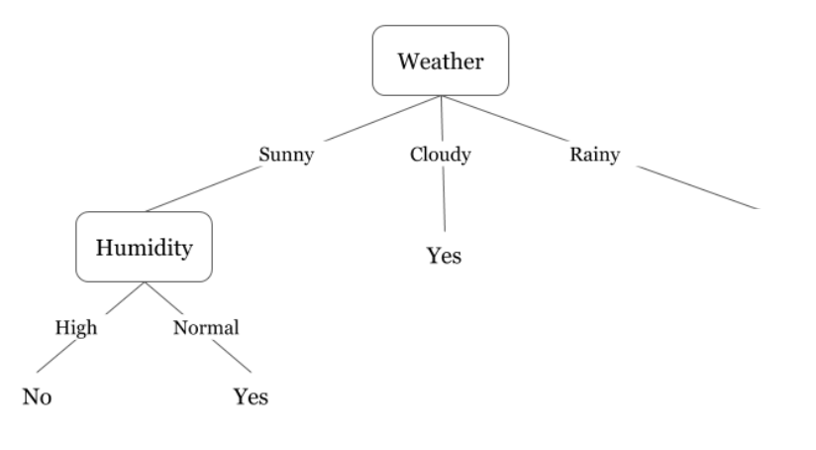
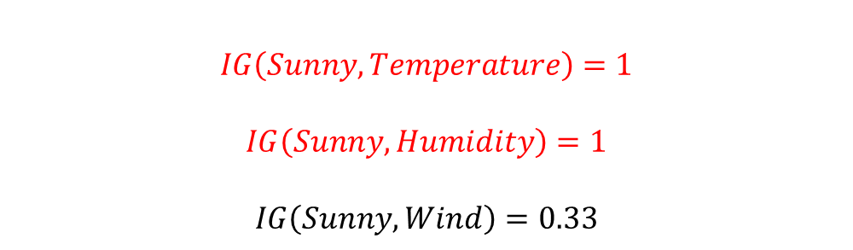
$$IG\left(Sunny, Temperature\right)=1$$
$$IG\left(Sunny, Humidity\right)=1$$
$$IG\left(Sunny, Wind\right)=0.33$$

Slide 26
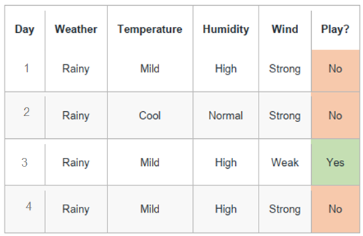
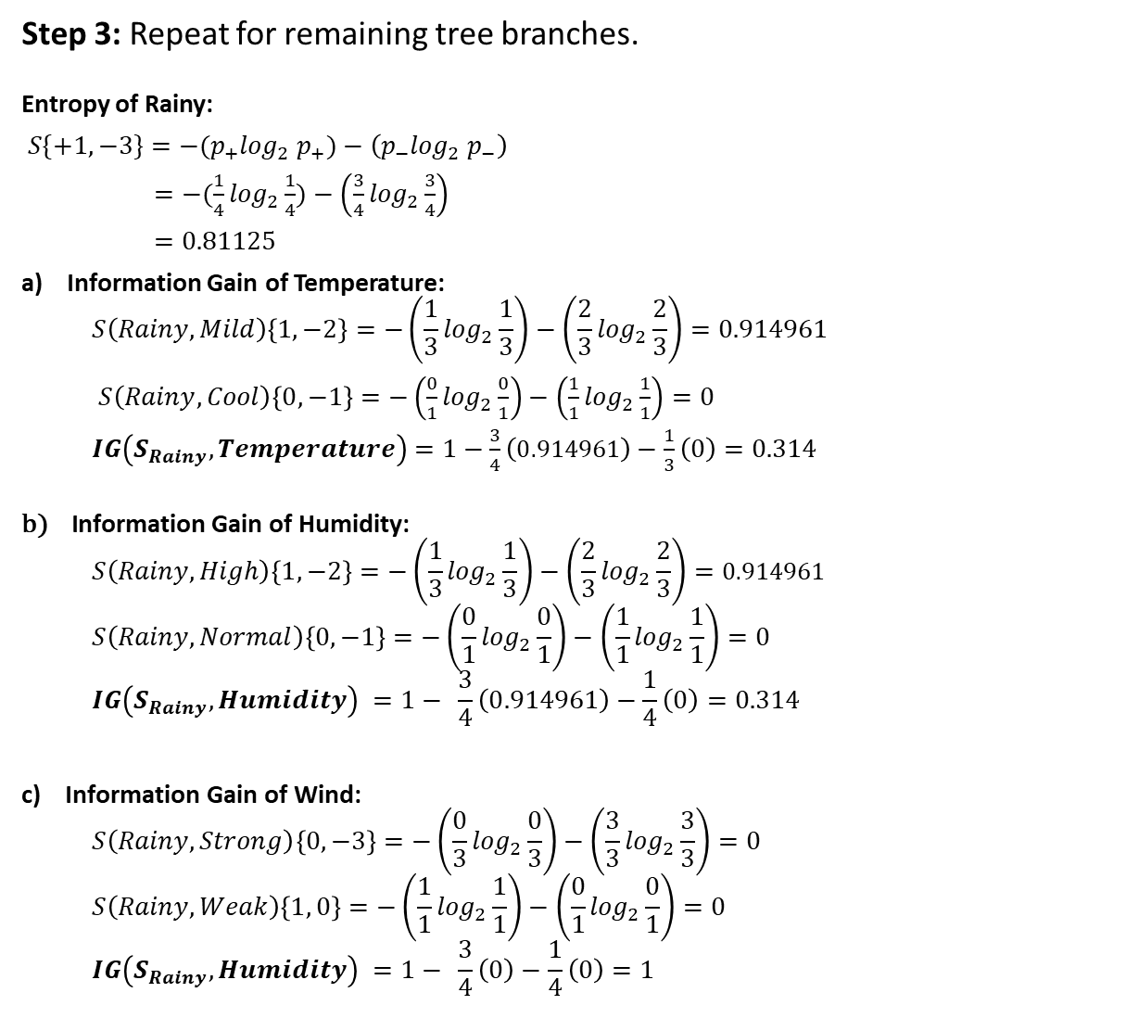
Step 3: Repeat for remaining tree branches.
Entropy of Rainy:
$S\{+1, −3\}={−(p}_{+}\log_{2}{ p}_{+})−\left(p_{−}\log_{2}{ p}_{−}\right)$
$=−(\frac{1}{4}\log_{2}\frac{1}{4})−\left(\frac{3}{4}\log_{2}\frac{3}{4}\right)$
$=0.81125$
a) Information Gain of Temperature:
$$S\left(Rainy, Mild\right)\left\{1, −2\right\}=−\left(\frac{1}{3}\log_{2}\frac{1}{3}\right)−\left(\frac{2}{3}\log_{2}\frac{2}{3}\right)=0.914961$$
$S\left(Rainy, Cool\right)\left\{0, −1\right\}=−\left(\frac{0}{1}\log_{2}\frac{0}{1}\right)−\left(\frac{1}{1}\log_{2}\frac{1}{1}\right)=0$
$IG\left(S_{Rainy}, Temperature\right)$ $=1−$ $\frac{3}{4}\left(0.914961\right)−\frac{1}{3}\left(0\right)=0.314$
$$\text{b}\text{) }\text{Information} \text{Gain} \text{of} \text{Humidity}\text{:}$$
$$S\left(Rainy, High\right)\left\{1, −2\right\}=−\left(\frac{1}{3}\log_{2}\frac{1}{3}\right)−\left(\frac{2}{3}\log_{2}\frac{2}{3}\right)=0.914961$$
$$S\left(Rainy, Normal\right)\left\{0, −1\right\}=−\left(\frac{0}{1}\log_{2}\frac{0}{1}\right)−\left(\frac{1}{1}\log_{2}\frac{1}{1}\right)=0$$
$$IG\left(S_{Rainy}, Humidity\right) =1− \frac{3}{4}\left(0.914961\right)−\frac{1}{4}\left(0\right)=0.314$$
c) $\text{Information} \text{Gain} \text{of} \text{Wind}\text{:}$
$$S\left(Rainy, Strong\right)\left\{0, −3\right\}=−\left(\frac{0}{3}\log_{2}\frac{0}{3}\right)−\left(\frac{3}{3}\log_{2}\frac{3}{3}\right)=0$$
$$S\left(Rainy, Weak\right)\left\{1, 0\right\}=−\left(\frac{1}{1}\log_{2}\frac{1}{1}\right)−\left(\frac{0}{1}\log_{2}\frac{0}{1}\right)=0$$
$$IG\left(S_{Rainy}, Humidity\right) =1− \frac{3}{4}\left(0\right)−\frac{1}{4}\left(0\right)=1$$

Slide 27
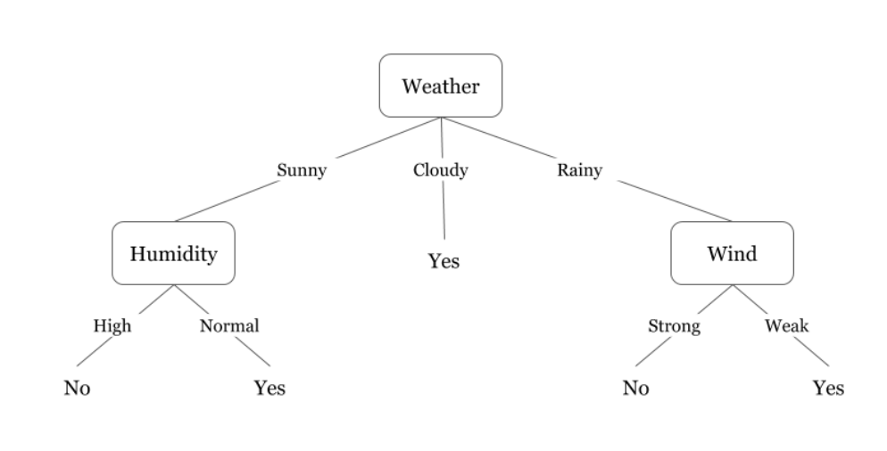
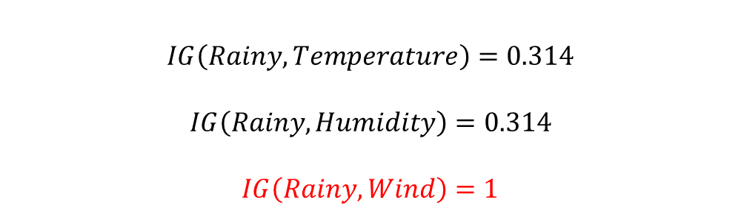
$$IG\left(Rainy, Temperature\right)=0.314$$
$$IG\left(Rainy, Humidity\right)=0.314$$
$$IG\left(Rainy, Wind\right)=1$$

Slide 28
Final Tree

Slide 29
Summary
Decision trees is one of the most widely used learning methods in practice
Can out-perform human experts in many problems
Strengths include
Fast
Simple to implement
Can convert result to a set of easily interpretable rules
Empirically valid in many commercial products
Handles noisy data
Weaknesses include:
Univariate splits/partitioning using only one attribute at a time so limits types of possible trees
Large decision trees may be hard to understand
Non-incremental (i.e., batch method)

